Slide 1
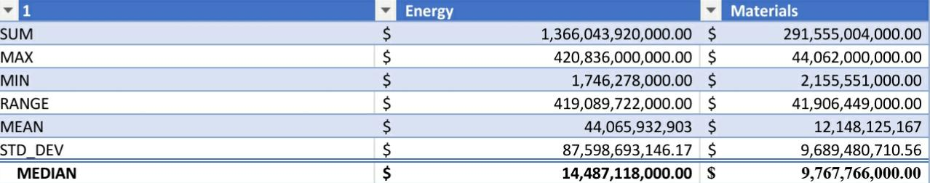
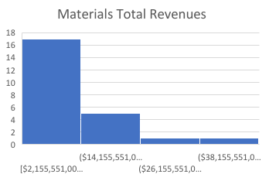
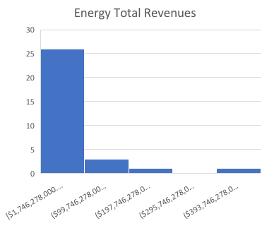
Is the development in total revenues for the Energy sector similar to the development in total revenues for the Materials sector during the second year?
The numbers
The numbers
Revenues
Revenues
Below are the total revenue histograms for the Materials and Energy sector companies reported to all companies.
Both histograms are right skewed; Given this, this means that the mean in both sectors is higher than the median.
Median (center value(
The median in the Energy sector is about (14,487,118,000)dollars, while in the Materials sector it is about (9,767766,000) dollars, meaning that the difference between the two sectors in terms of the median is about 48%.
Mean)average(
The average in the energy sector is about (44,065,932,903) dollars, while in the materials sector it is (12,148,125,167) dollars. That is, the average total revenue for the energy sector is about three times the average of all revenues for the hardware sector .
Range
The range in the energy sector is (419,089,722,000) dollars, the range in the hardware sector is about (41,906,449,000) dollars, meaning that the range in the energy sector is equal to about ten times the range in the hardware sector
standard deviation The standard deviation in the energy sector is approximately $ 87,598,693,146, while in the materials sector it is approximately 9,689,480,710.$ We notice that the standard deviation is much greater in the energy sector than in the hardware sector, and we also note that the dispersion in the data for energy specialization is the largest.

